Slide 1

Med itech HealthCare Analytics
Role – Data Analyst

Slide 2
About Med itech
Global healthcare IT company headquartered in Massachusetts, USA
Founded in 1969.
Strong presence in world wide healthcare system.(Canada, UK, Asia, Australia, Africa and Europe)
Provides Electronic Health Record (EHR) systems
Manages hospital clinical, financial, and operational data
Supports revenue cycle management and billing systems

Slide 3
Project Overview
Design a centralized healthcare data pipeline with Delta Incremental Load by using Azure SQL database, Azure Data Factory and Power BI.
Deliver business insights through Power BI dashboards.
Implement data security by using Role-Based Access Control (RBAC) and Row-Level Security (RLS)

Slide 4
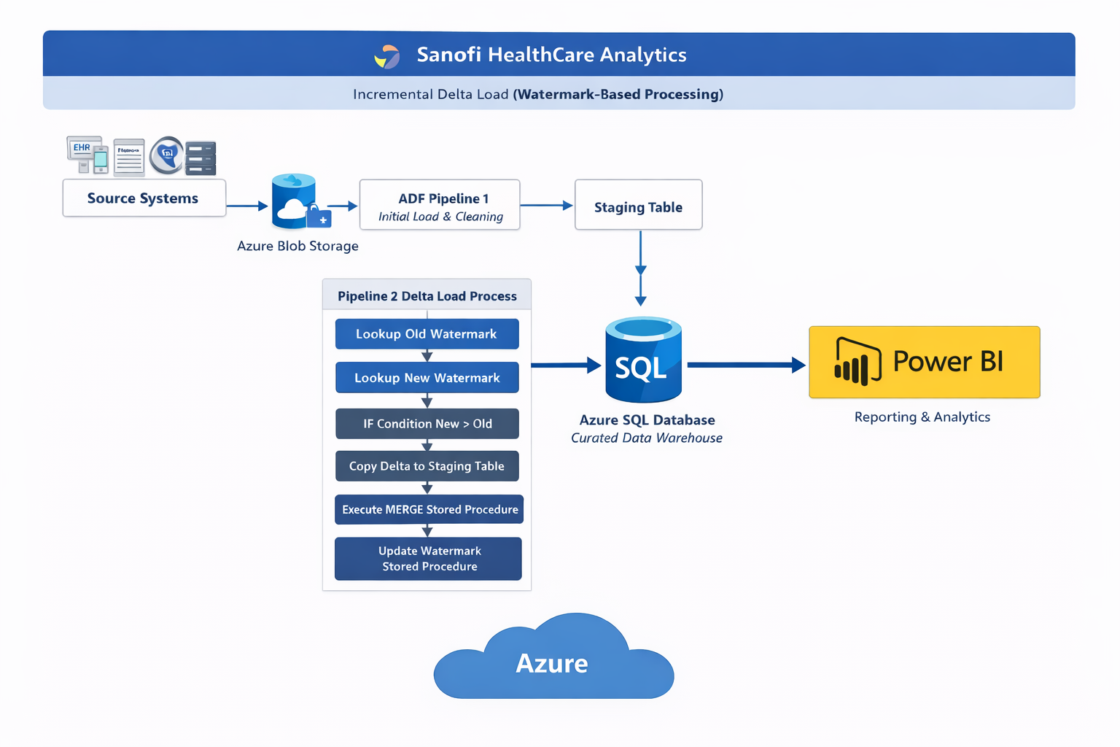
Project Architecture Overview

Slide 5
Team Members
There are 12 team members :-
Project Manager
Solution Architect
Azure Data Engineer (2)
Azure SQL Developer
Power BI Developer(2)
BI Analyst
Data Quality & Testing Engineer
Cloud / Platform Support Engineer
Scrum Master
Subject Matter Expert (part time)

Slide 6
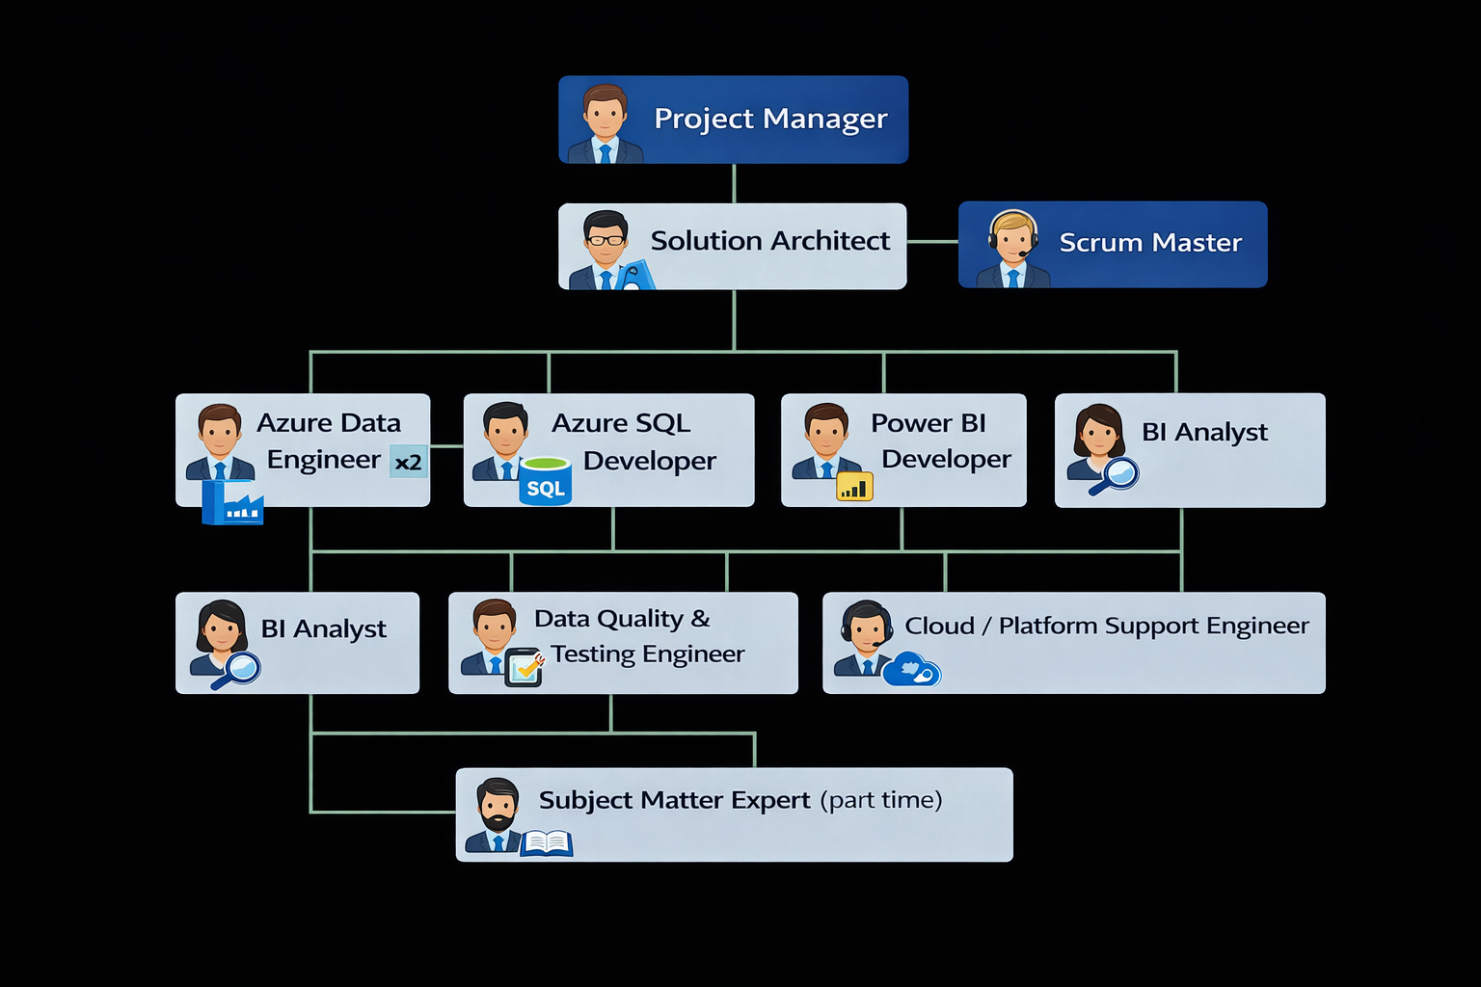

Slide 7
Situation
Multiregional Healthcare organization was struggling to collect the data from different operational systems (on cloud & on –Prem) include EHR, Billing system, HR system, PMS, Finance System in different formats.
No centralized data warehouse.
No delta incremental load mechanism.
Performance issue due to full load.
Mostly reporting process was manual.
Inconsistent, delayed and sometime inaccurate Reporting.
These impact the business like delayed and time consuming reports and decisions. System performance was inefficient.

Slide 8
Task
Design and implement an end-to-end automated data pipeline
Collect the data from heterogenous sources.
Centralize data into Azure
Implement delta incremental loading.
Schedule the pipeline.
Deliver business-ready dashboards in Power BI
Implement RBAC and RLS.
Star schema is used for data mdeling.
Support agile delivery with clear reporting requirements.
Meets the requirement of User Acceptance Testing(UAT).

Slide 9
Action
Data Ingestion
Integrated cloud and on-prem systems
Stored raw CSV files in Azure Blob Storage
Data Cleaning & Transformation
Using Azure Data Factory (Pipeline 1):
Extracted data from Blob Storage
Removed nulls and duplicates
Standardized date formats
Validated and cleaned records

Slide 10
Action cont.…
Join and Loaded curated data into Azure SQL Database
In Azure SQL database , create watermark table , staging table and two stored procedure for merge the updating in source table and update the watermark value.
Implemented watermark value based Incremental delta Load (Pipeline 2)
Used two Lookup activities:
  Old watermark
  New watermark
  Then add IF condition:
  If New watermark value > Old watermark value → process delta
  Truncate the staging table by writing a statement in pre-copy script and copy new and updated records in staging table as a temporary storage.

Slide 11
Action
  Then to merge the updated records into source table execute merge stored procedure
  Then Executed stored procedure to update watermark
  Scheduling the pipelines for every 24 hours.
Reporting
For reporting connect the Azure SQL Database with Power BI and design the dashboards by using different KPIs and DAX measures.
Implemented Role-Based Access Control (RBAC) and Row-Level Security (RLS) to ensure secure data access
Established monitoring and support processes to maintain pipeline reliability and ongoing performance optimization.

Slide 12
Result
Data ingestion and reporting became fully automated
Pipeline performance improved reducing load times by up to 60–80%.
Centralized Azure data platform provided a single source of truth worthy data, .
Power BI dashboards speed up the reporting and decision making process.
Security of data accessed through RBAC and Row-Level Security implementation.
Successful UAT sign-off from business stakeholders confirmed the solution meets the requirements.
Overall reporting cycle time was reduced, allowing leadership to make more timely and data-driven decisions.

Slide 13
Challenges
Heterogenous source system.
Bottleneck performances
Data Quality issue.
Data Security.
Multi regional requirements

Slide 14
Tools and Technologies
Microsoft Azure – Primary cloud platform
Azure Data Factory (ADF) – ETL/ELT orchestration
Azure Blob Storage – Raw data landing zone
Azure SQL Database – Centralized data warehouse
Azure Monitor – monitor the performance of storage , pipeline
JIRA- defect tracking for UAT
Microsoft Power BI – for reporting.
SSMS (on prem data)

Slide 15
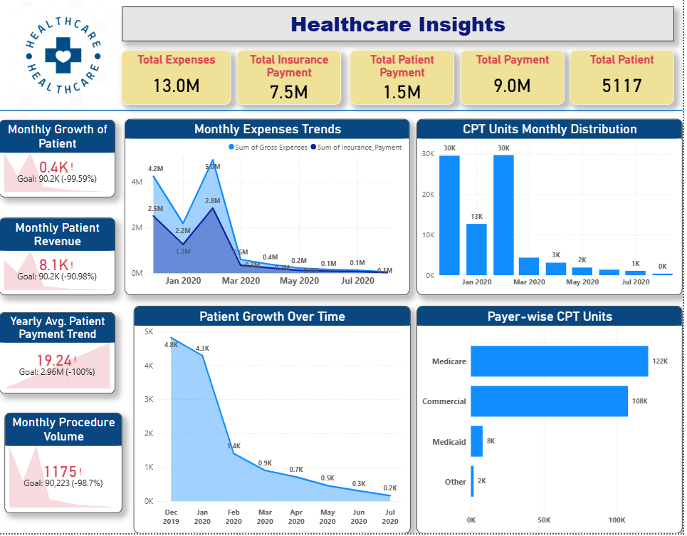

Slide 16
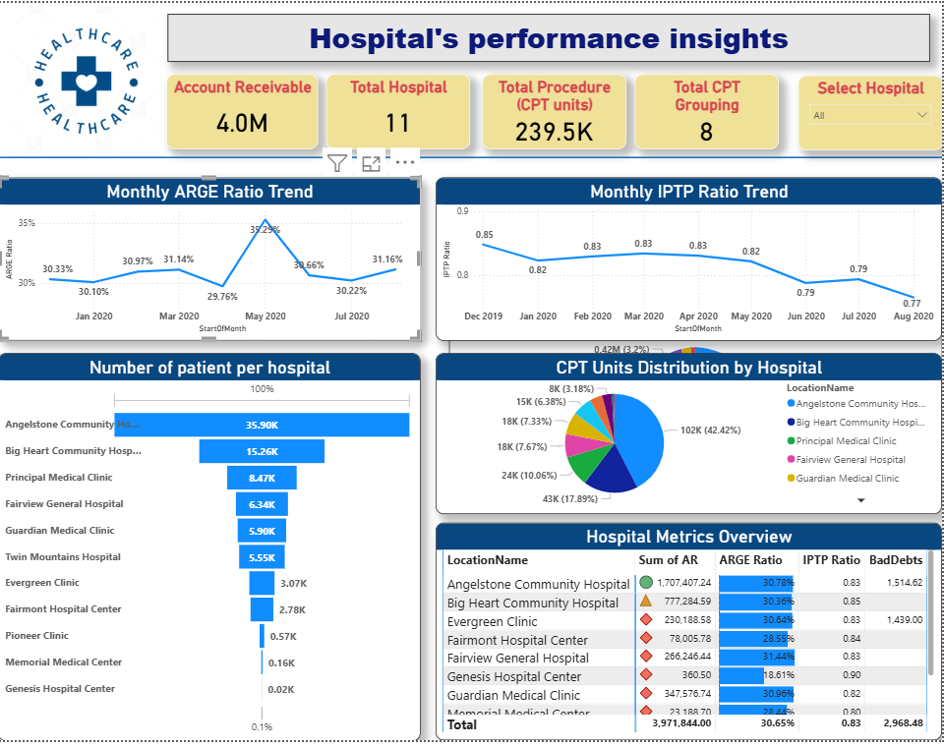

Slide 17
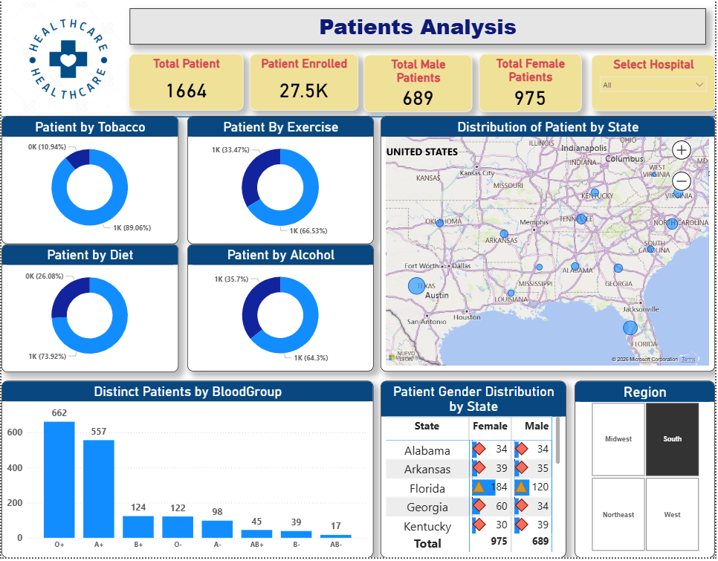

Slide 18
